Slide 1

Olympic Games Performance
IST 707 Final Project
Jocelyn Pitman
&
Kelly Schillaci

Slide 2
The Data
Kaggle: “120 years of Olympic history: athletes and results”
Full data set is 271,000 rows by 15 columns
Contains full data for 51 different Olympic games, both Summer and Winter, between 1896 and 2016

Slide 3
Data Structure
Nominal Variables:
ID
Name
Sex
Team/NOC
Games
Season
City
Sport
Event
Medal
Numerical Variables:
Age
Height
Weight
Year

Slide 4
End Goal
The purpose of this project is to determine whether athlete performance at the Olympic games can be predicted.
Can the winner of a certain event be predicted?
Can important factors in athlete performance be determined?

Slide 5
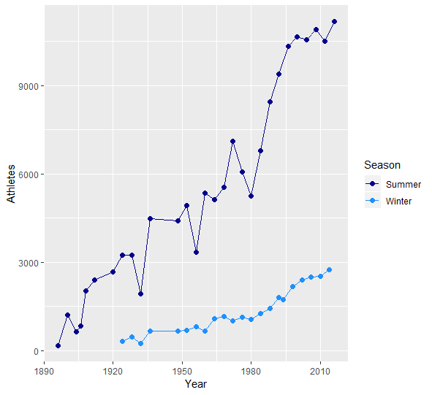
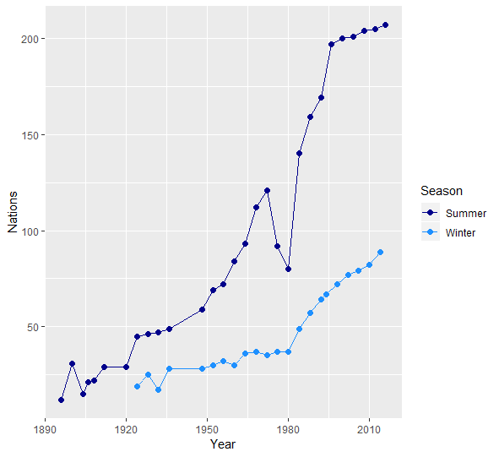
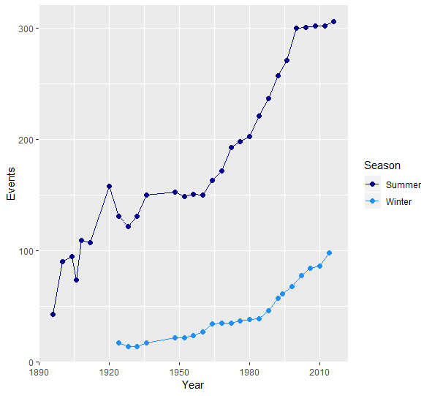
Athletes by Season
Athletes by Season
Nations by Season
Events by
Season
Winter vs Summer Games

Slide 6
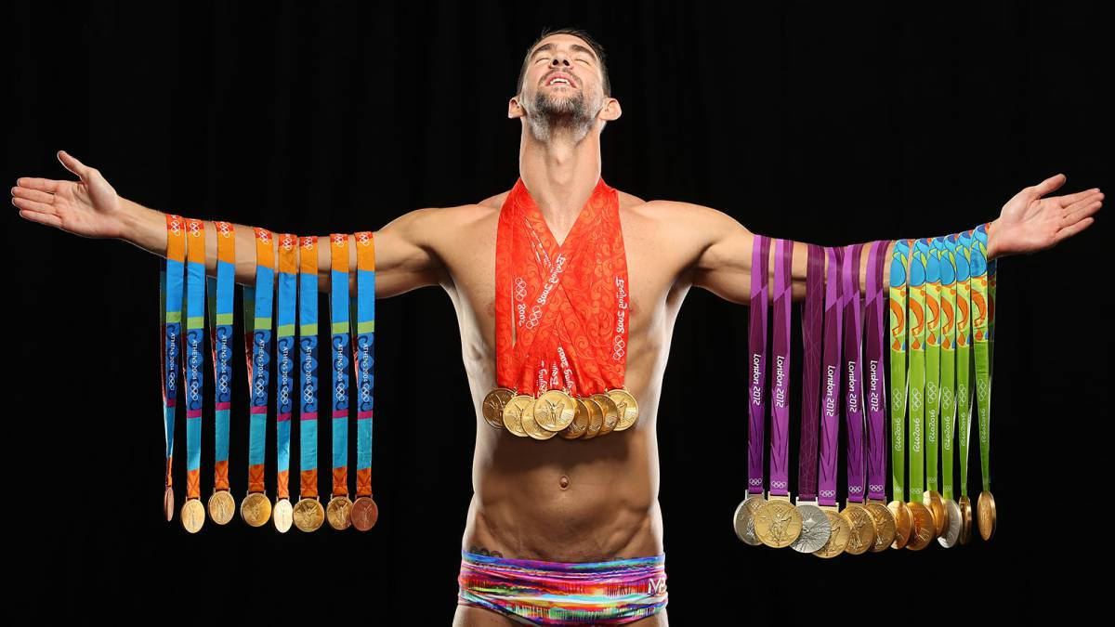

Slide 7
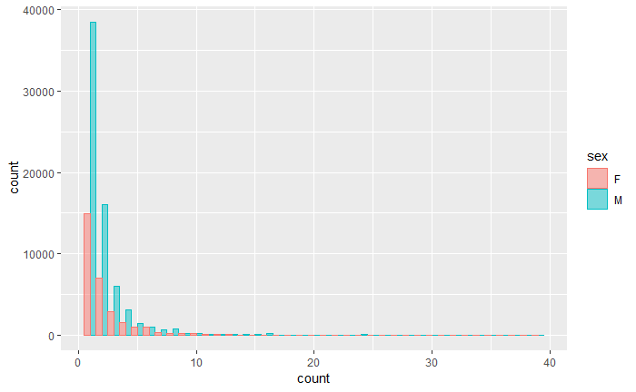
Events Competed in During Olympic Career

Slide 8
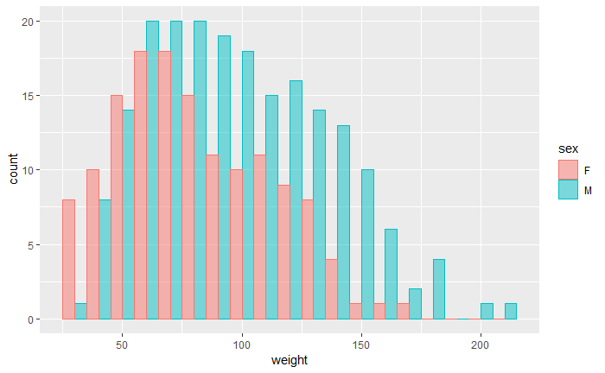
Weight Distribution by Athlete Gender

Slide 9
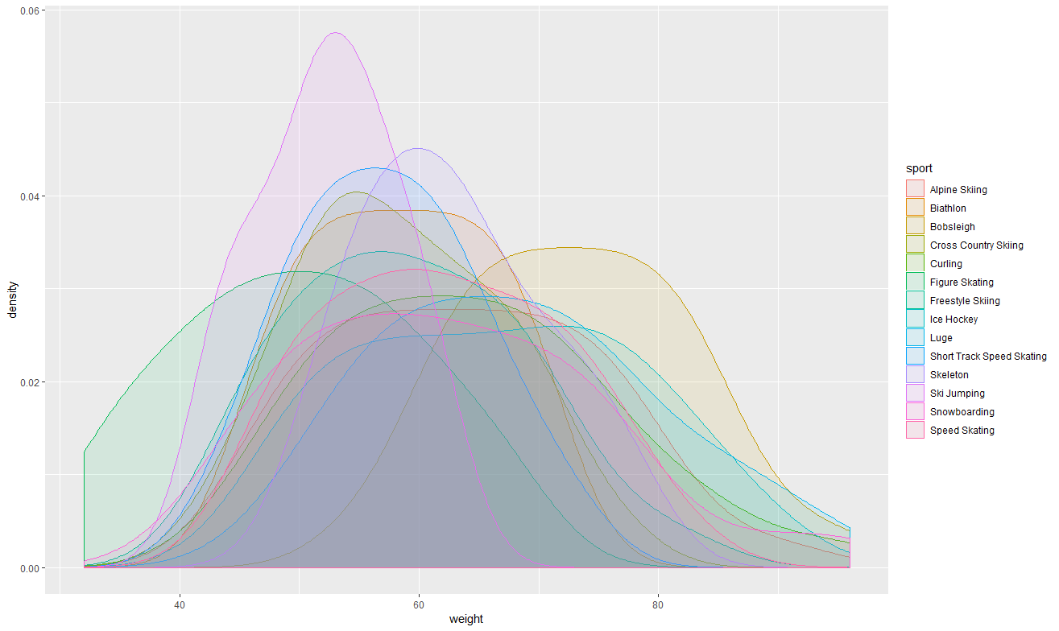
Female Winter Sports Weight Distribution

Slide 10
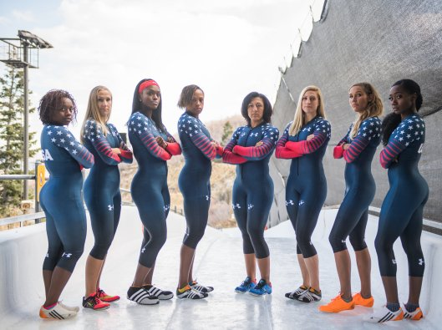
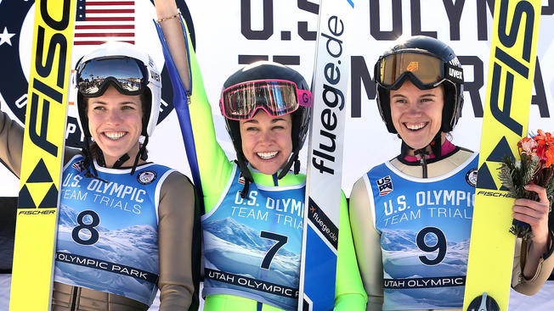
Bobsleigh vs Ski Jumping

Slide 11
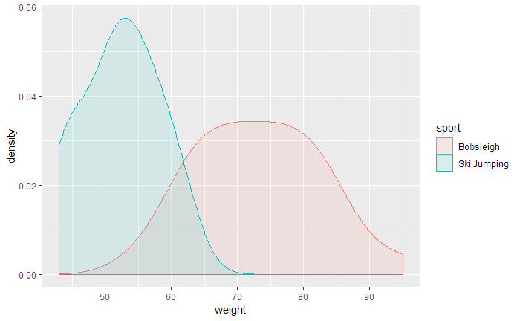
Female Winter Sports Weight Distribution (Bobsleigh & Ski Jumping)

Slide 12
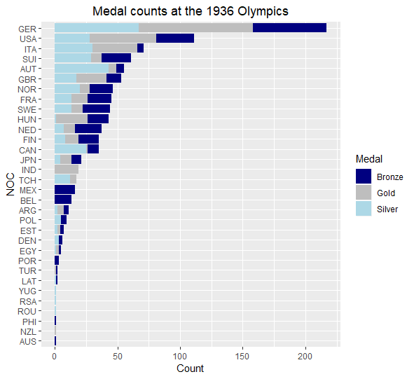
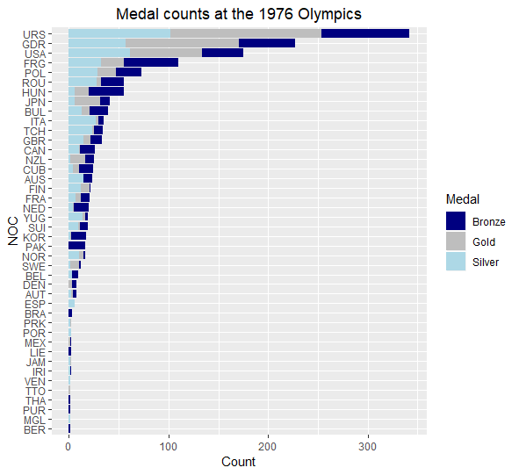
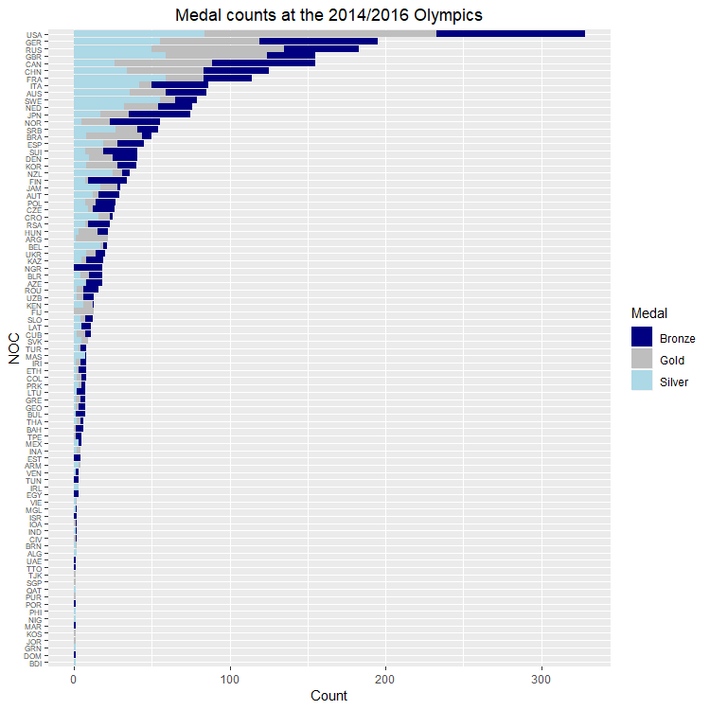
Evolution of Medal Counts over Time

Slide 13
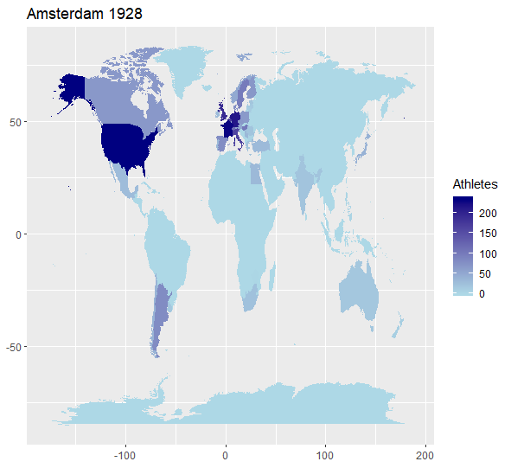
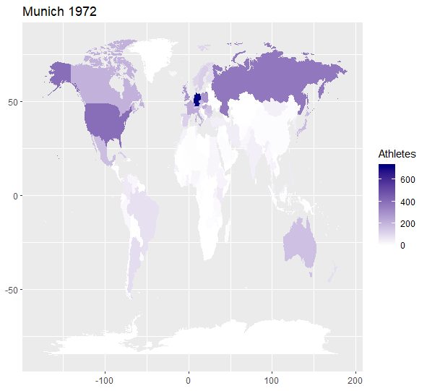
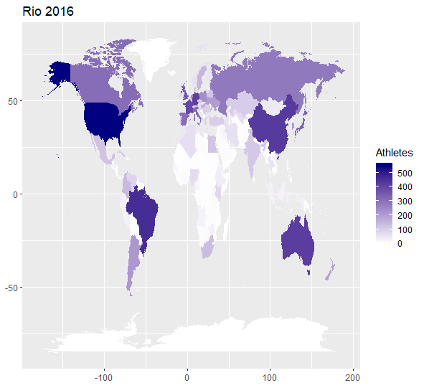
Team Size by Year & Region

Slide 14
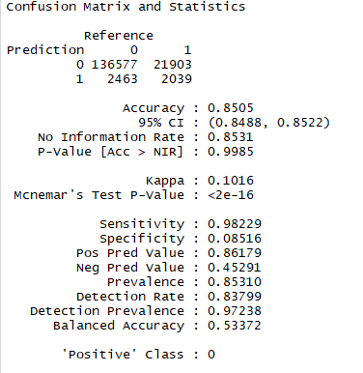
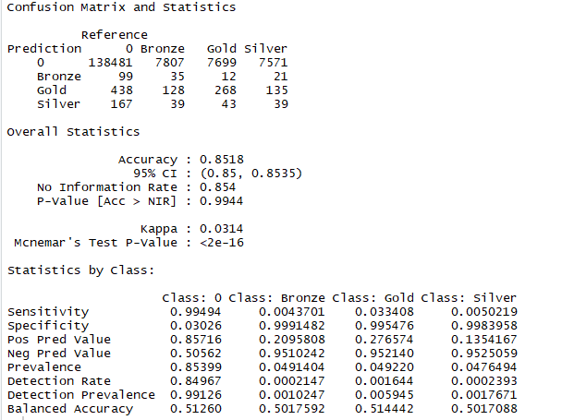
Naïve Bayes
Age
Weight
Height
Team
Medal

Slide 15
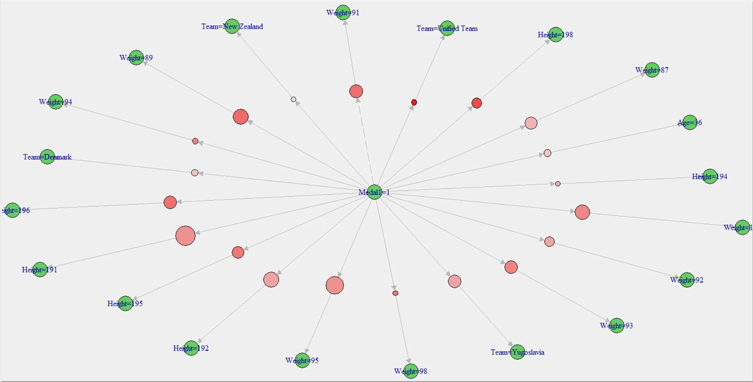
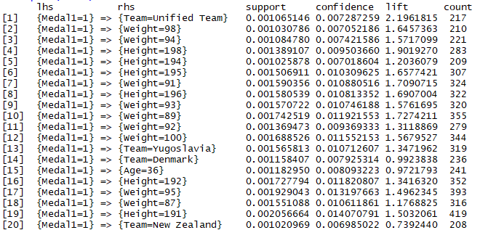
Association Rule Mining

Slide 16
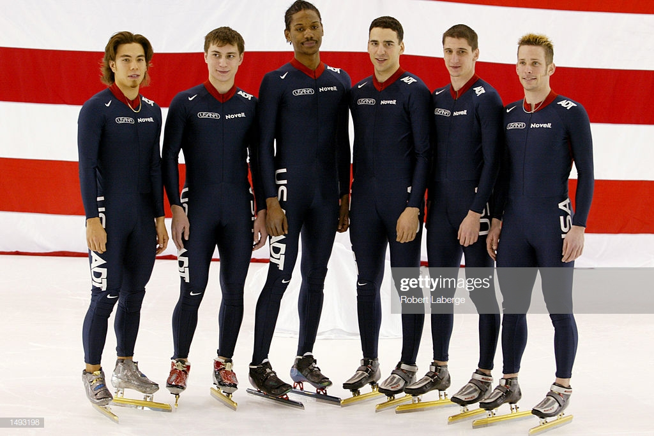
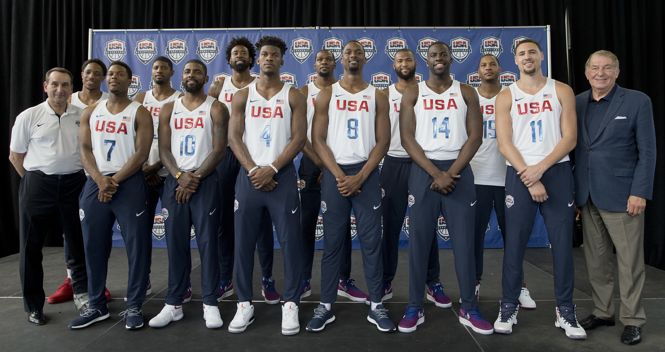
Men’s Basketball vs Speed Skating

Slide 17
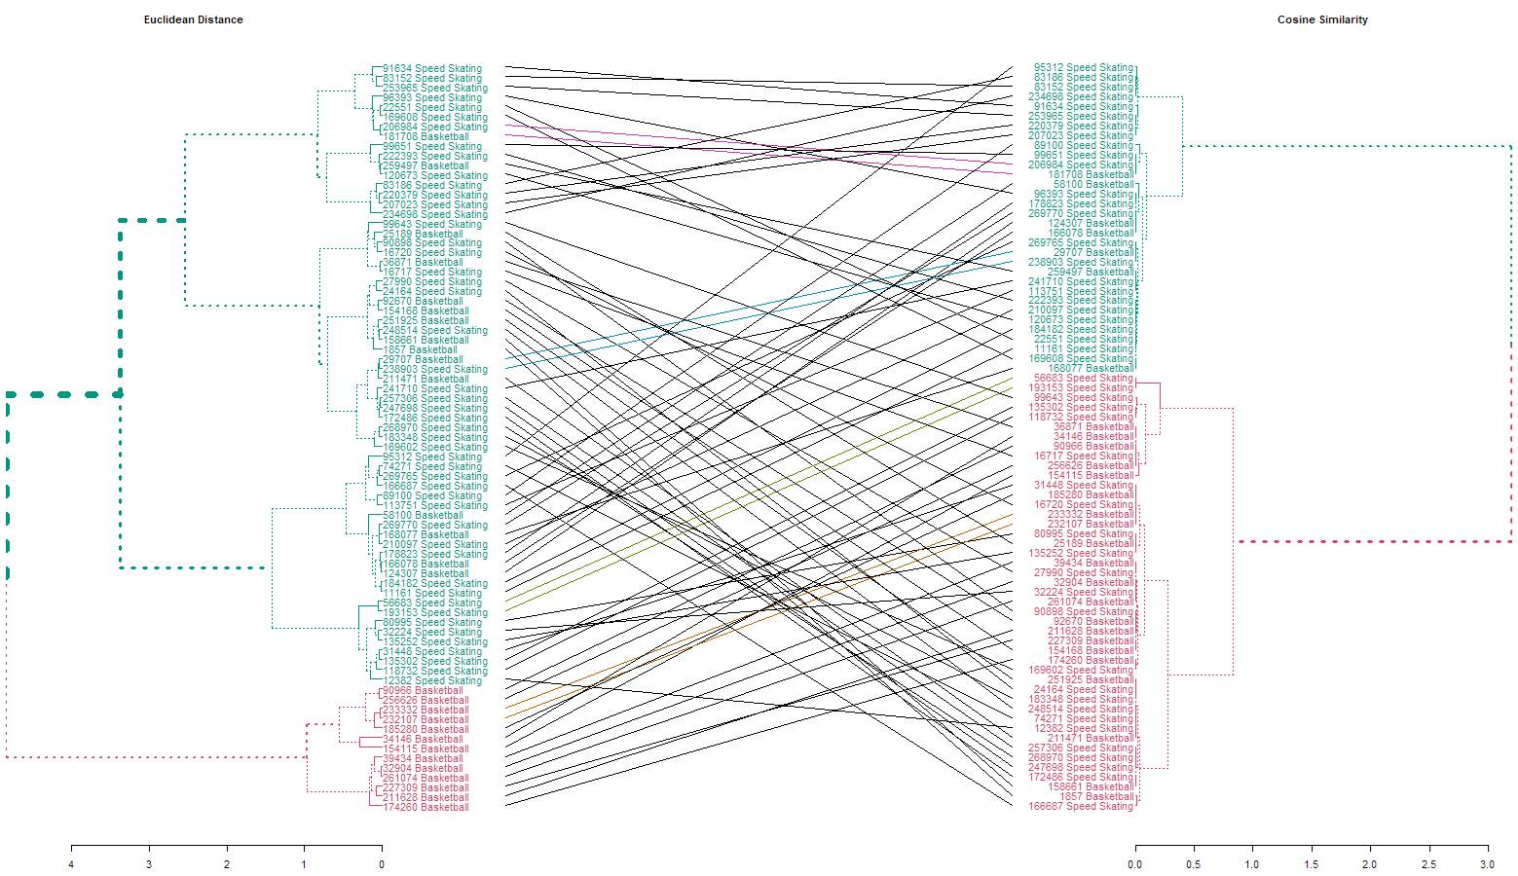
Hierarchal Clustering

Slide 18

Conclusions
Can the winner of a certain event be predicted?
Can important factors in athlete performance be determined?

Slide 19
Thank you!
Questions or Comments?

